Slide 1
Emerging Technology in the education industry
Mohamed Firas Faisal

Slide 2
Contents
Introduction
Artificial intelligence
Augmented reality
Mobile learning
3D printing
Learning through Games
References

Slide 3
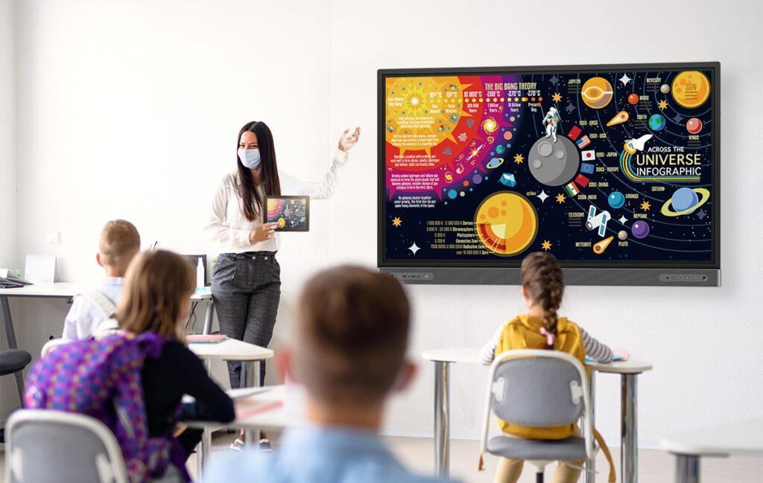
Introduction
Education on the Brink: A Glimpse into Emerging Technologies
Imagine classrooms where textbooks dissolve into interactive holograms, personalized learning maps guide each student's journey, and robots act as tireless tutors. This isn't science fiction, it's the near future of education fueled by emerging technologies. The traditional brick-and-mortar schoolhouse is undergoing a metamorphosis, and these innovations are poised to reshape the way we learn and teach.
From artificial intelligence tailoring educational experiences to virtual reality transporting students to the heart of historical events, the possibilities are boundless.

Slide 4
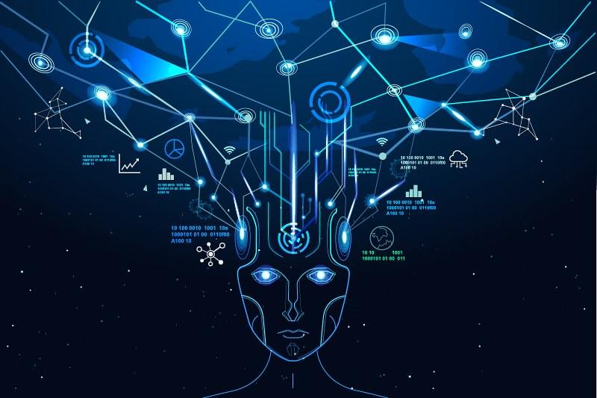
Artificial intelligence
Artificial intelligence (AI), the ability of a digital computer or computer-controlled robot to perform tasks commonly associated with intelligent beings.
monitor students’ progress, spot areas for development, and modify the course contents as necessary.
A good example of an AI used in learning is the duolingo app.
Other ways AI can be used:
Producing smart content
Contributing to task automation
Ensuring universal access to education
Providing 24*7 assistance
Customizing information for every individual

Slide 5
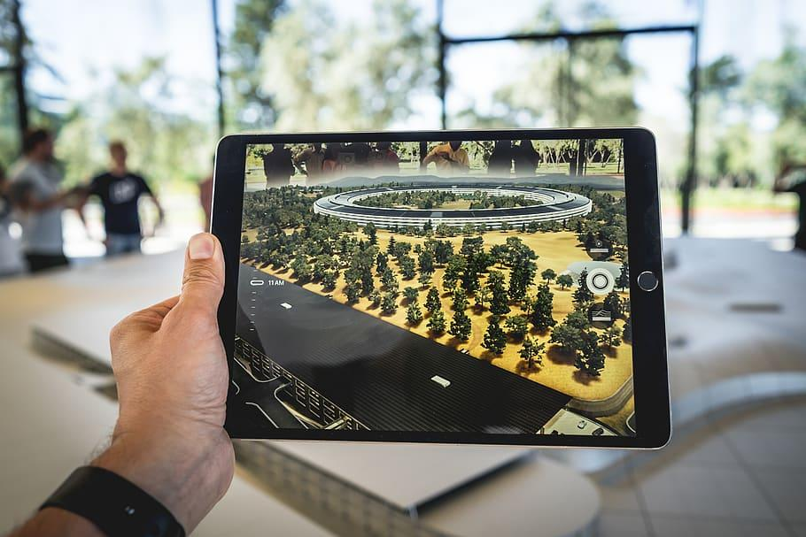
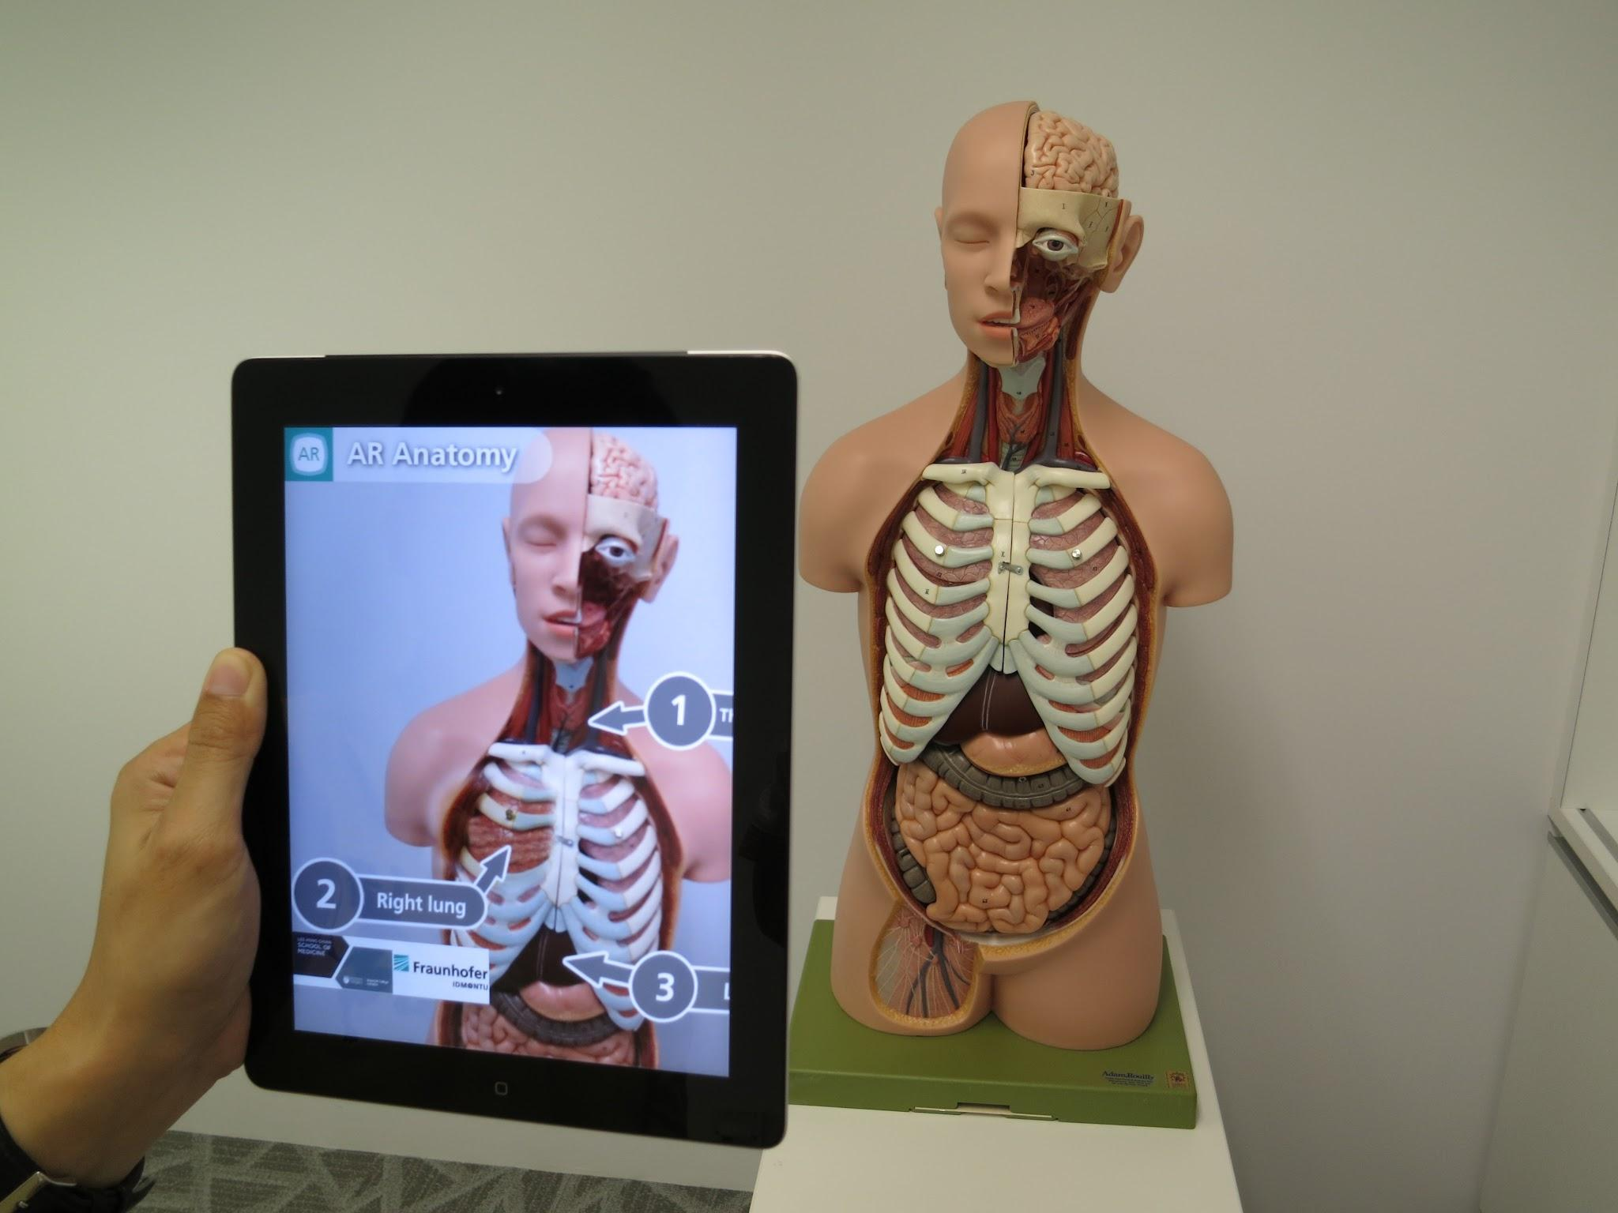
Augmented Reality
Augmented reality (AR) is the integration of digital information with the user's environment in Real Time. Unlike virtual reality (VR), which creates a totally artificial environment, AR users experience a real-world environment with generated perceptual information overlaid on top of it.
AR’s relative seamlessness of digital objects within the “real world” encourages interactivity and engagement.
It maximizes students’ ability to spend their time learning curricular subjects while minimizing the time spent learning how to use the new tech.
AR can also inspire empathy in an individual. It offers two-dimensional methods of presenting information versus the traditional one-dimension. This combination of interactivity and engagement with emotion, in turn, could enhance the ability of students to remember what they’ve learned– and lead to faster acquisition of information and skills.

Slide 6

Mobile learning
Mobile learning, or mLearning, is a type of technology-enhanced education that takes place on a mobile device.
it provides a more convenient and flexible way to learn, allowing learners to fit education into their busy schedules.
Furthermore, it can increase accessibility to education for individuals who may not have access to traditional classroom settings.
Mobile learning can also be more cost-effective than traditional classroom-based learning
Mobile learning can also improve collaboration among learners, as it provides a platform for communication and collaboration in real time.
With features like discussion boards, instant messaging, and group projects, mobile learning can foster a sense of community and collaboration among learners

Slide 7
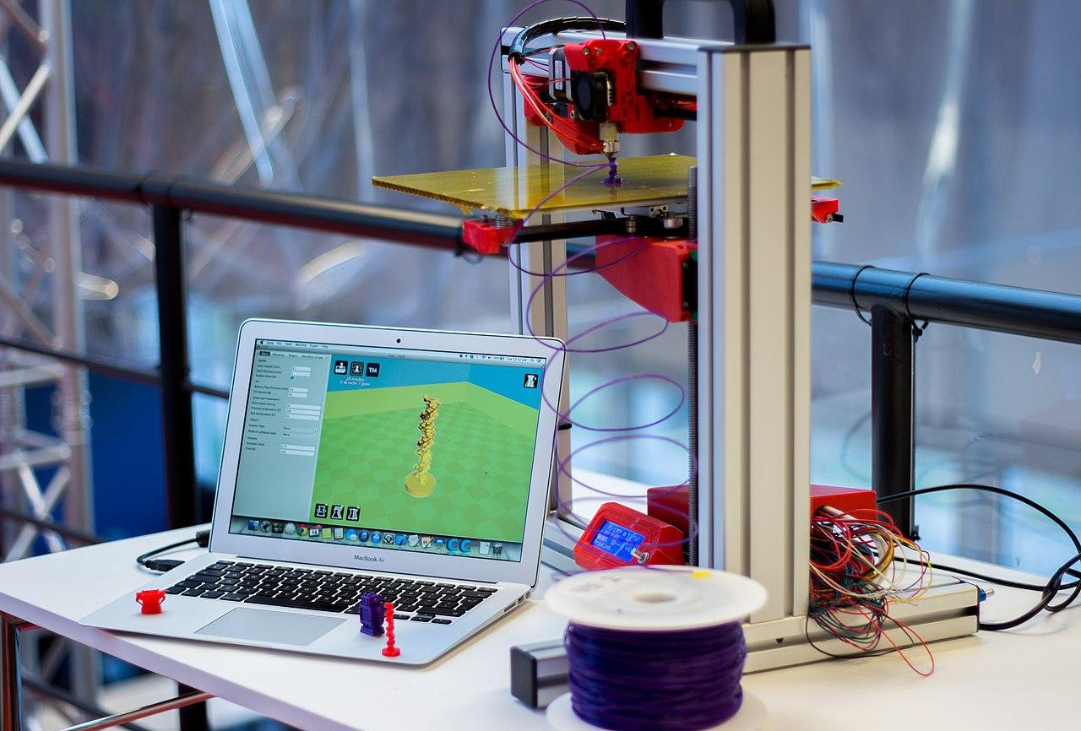
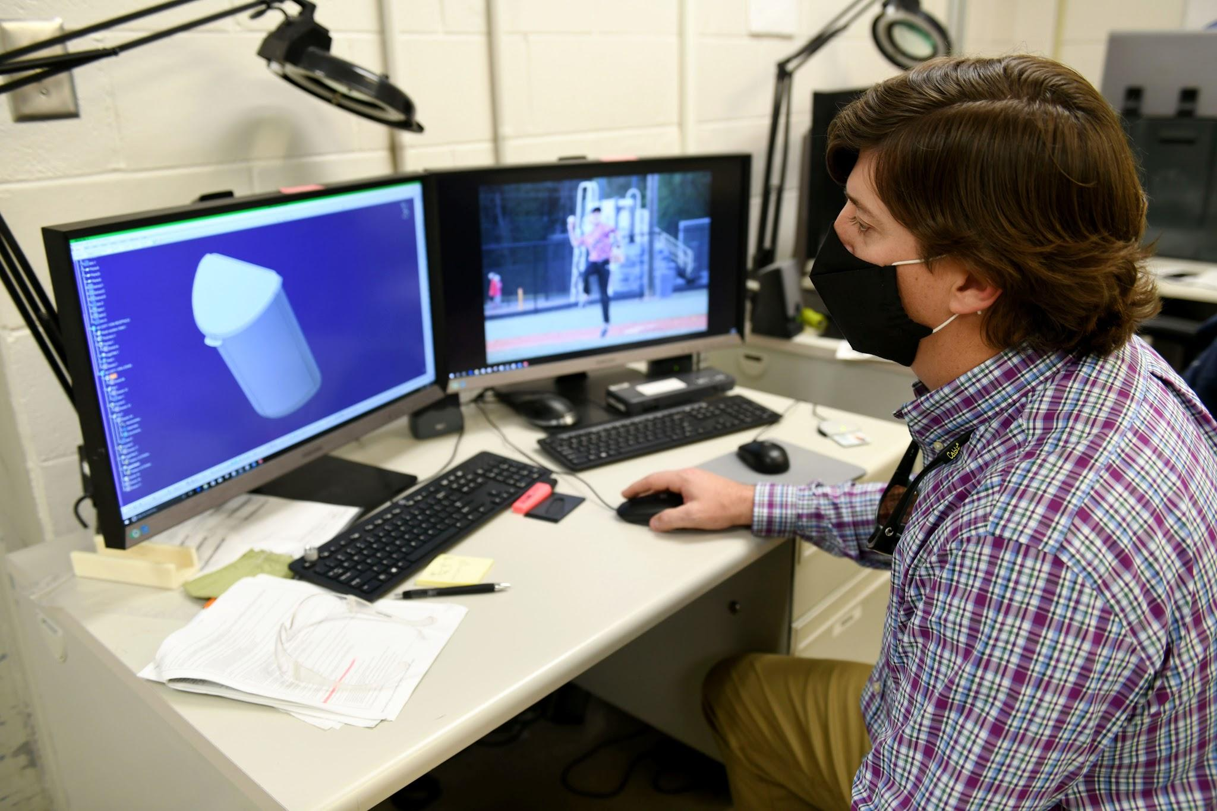
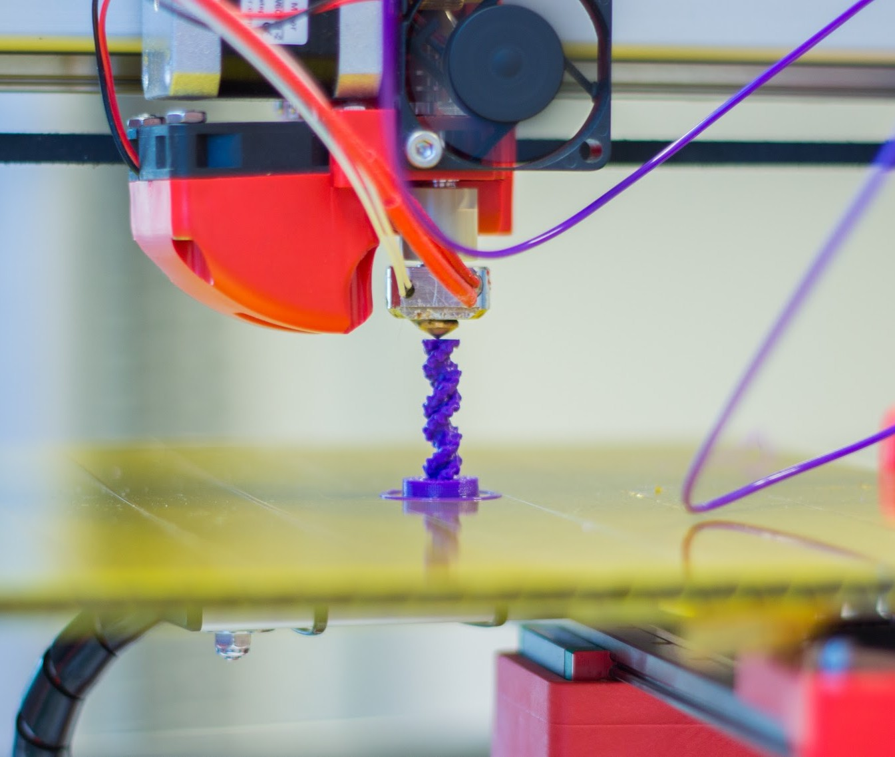
3D printing
While 3D printing is four to five years away from widespread adoption in schools, it is easy to pinpoint the practical applications that will take hold. Geology and anthropology students, for instance, can make and interact with models of fossils and other artifacts, and organic chemistry students can print out models of complex proteins and other molecules through rapid prototyping and production tools. Even more compelling are institutions that are using 3D technology to develop brand new tools.

Slide 8
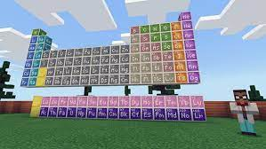
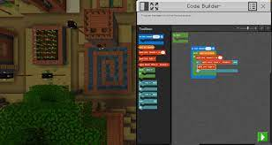
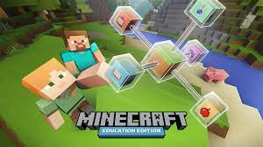
Learning through games
Game play has traversed the realm of recreation and infiltrated commerce, productivity, and education, proving to be a useful training and motivation tool. Referred to as “Game-Based Learning” in previous NMC Horizon reports, this field of practice has expanded far beyond integrating digital and online games into the curriculum. The updated category title reflects the perspective that while games are effective tools for scaffolding concepts and simulating real world experiences, it should also include the larger canvas of gamer culture and game design. A good example of this is Minecraft education edition

Slide 9
References
https://www.britannica.com/technology/artificial-intelligence
https://appinventiv.com/blog/10-ways-artificial-intelligence-transforming-the-education-industry/#:~:text=AI%20systems%20monitor%20students'%20progress,as%20they%20advance%20their%20proficiency
https://www.techtarget.com/whatis/definition/augmented-reality-AR
https://www.viewsonic.com/library/education/6-benefits-and-5-examples-of-augmented-reality-in-education/#:~:text=Augmented%20Reality%20(AR)%20in%20education,on%20technical%20knowledge%20and%20proficiencies
https://elearningindustry.com/mobile-learning-benefits-the-advantages-of-learning-on-the-go#:~:text=For%20example%2C%20it%20provides%20a,interactive%20and%20personalized%20learning%20experience
https://edu.google.com/intl/en_uk/future-of-the-classroom/emerging-technologies/

